Slide 1
Presentation on Wrapper Classes, String Classes, and Exception Handling in Java
Group: G-29
By: Aditya Kaushik
Aditya Suresh Barahate
Ajit Nanaji Pawar
Ajith Appi Naik

Slide 2
Introduction
Wrapper Classes
String Class (including StringBuffer and StringBuilder)
Exception Handling

Slide 3
What are Wrapper Classes?
Definition: Wrapper classes provide a way to use primitive data types (int, char, etc.) as objects.
List of Wrapper Classes: Integer, Byte, Long, Float, Double, Short, Character, Boolean.

Slide 4
Why Use Wrapper Classes?
Allow primitives to be used in collections (e.g., ArrayList).
Provide utility methods (e.g., parsing strings to numbers).
Auto-boxing and unboxing (automatic conversion between primitives and their wrapper objects).

Slide 5
Commonly Used Wrapper Classes
Integer: Methods like parseInt(), valueOf().
Double: Methods like parseDouble(), valueOf().

Slide 6
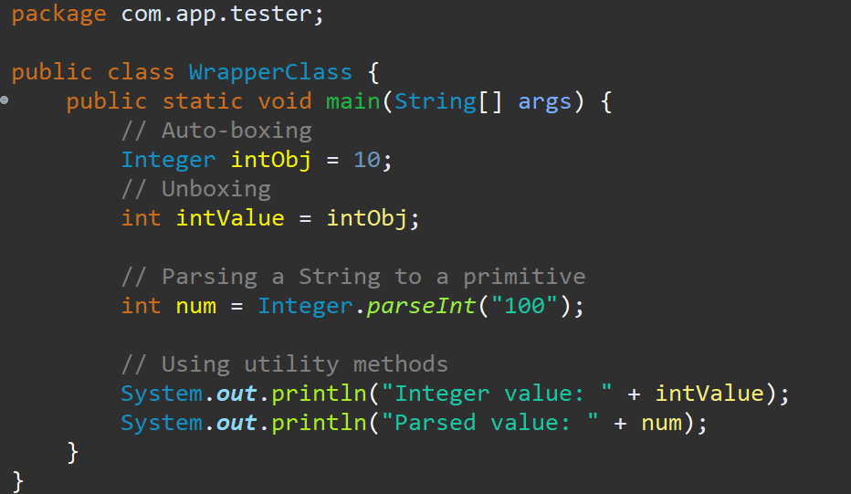
Sample Java Code for Wrapper Classes

Slide 7
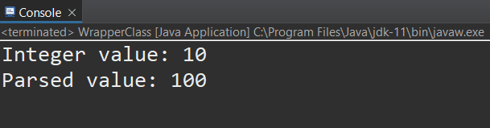
Sample Java Code for Wrapper Classes

Slide 8
Introduction to the String Class
Definition: String classes are data structures that represent sequences of characters and provide methods for manipulating text, including concatenation, comparison, and searching.
Immutable nature of String objects.

Slide 9
Common String Methods
length()
charAt(int index)
substring(int beginIndex, int endIndex)
indexOf(String str)
toUpperCase(), toLowerCase()
trim()

Slide 10
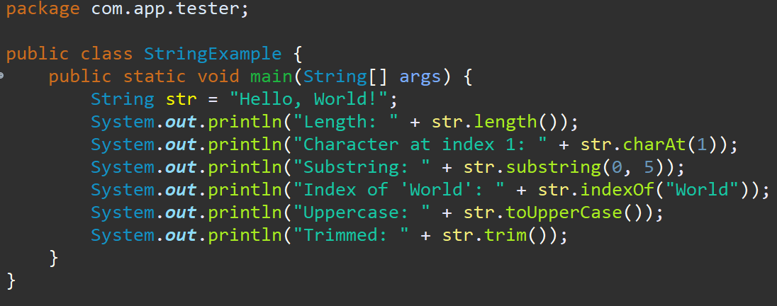
String Manipulation Examples

Slide 11
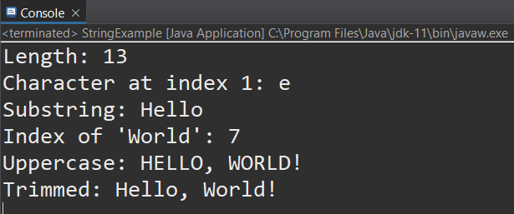
String Manipulation Examples

Slide 12
String Pool Concept
The String Pool is a special memory region in the Java heap used to store string literals.
When a string literal is created, the JVM checks the pool; if the string exists, it returns the reference, otherwise, it adds the string to the pool.
String interning helps save memory by avoiding the creation of multiple instances of identical strings.
Using the String Pool can improve performance due to faster comparisons, as identical string literals point to the same memory reference.

Slide 13
Introduction to StringBuffer and StringBuilder
Mutable sequence of characters.
Difference between String, StringBuffer, and StringBuilder.
StringBuffer: Thread-safe (synchronized).
StringBuilder: Not thread-safe (faster for single-threaded applications).

Slide 14
Common Methods of StringBuffer and StringBuilder
append(),
insert(),
reverse(),
delete(),
capacity(),
ensureCapacity()

Slide 15
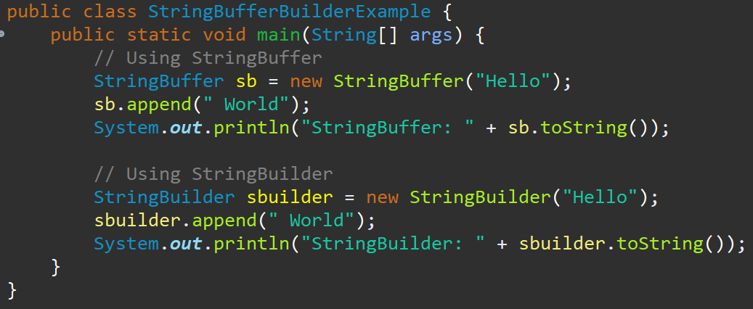
Sample Java Code for StringBuffer and StringBuilder

Slide 16
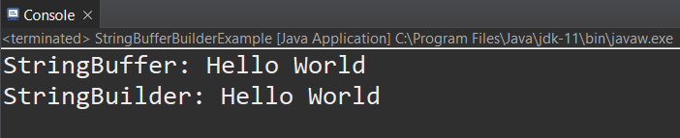
Sample Java Code for StringBuffer and StringBuilder

Slide 17
Introduction to Exception Handling
Definition: Mechanism to handle runtime errors.
Importance of exception handling in Java.
Error Management: Detects and handles runtime errors gracefully, preventing crashes.
Maintainability: Centralized error-handling logic, making code cleaner and easier to maintain.
Resource Management: Ensures proper release of resources to prevent leaks and maintain stability.

Slide 18
Types of Exceptions
Checked Exceptions : Must be declared or handled in the code, ensuring predictable and recoverable error management. e.g., IOException
Unchecked Exceptions : Runtime exceptions that indicate programming errors and do not need explicit handling. e.g., ArithmeticException, NullPointerException
Errors : Serious issues typically caused by the environment, often beyond the application's control and not meant to be caught. e.g., OutOfMemoryError

Slide 19
Exception Handling Keywords
try: Block of code to be tested for errors.
catch: Block of code to handle the error.
finally: Block of code that will execute regardless of an error.
Example code demonstrating basic try-catch-finally block.

Slide 20
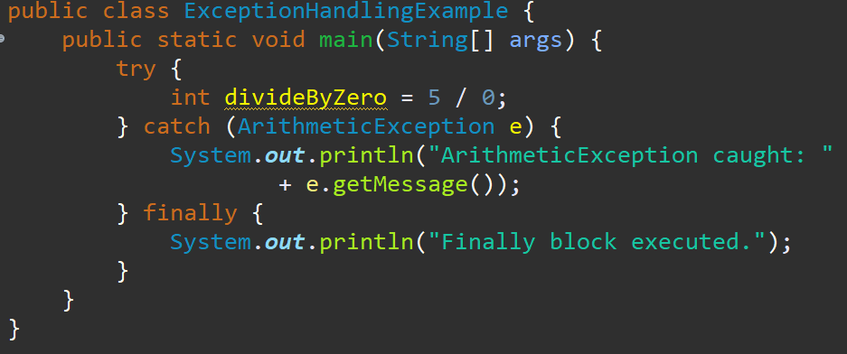
Sample Java Code for Basic Exception Handling

Slide 21
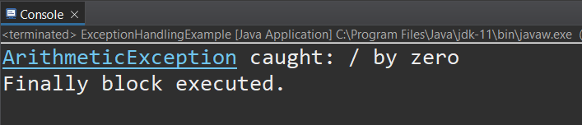
Sample Java Code for Basic Exception Handling

Slide 22
Advanced Exception Handling
throw: Used to explicitly throw an exception from a method or block of code, enabling custom error handling.
throws: Used to declare an exception in a method signature, indicating that the method might throw the specified exceptions.

Slide 23
Custom Exceptions
Creating user-defined exceptions: Allows developers to define custom exception classes based on specific application requirements, enhancing error reporting and handling.
Customized error messaging: Enables precise error messaging based on the application's context, improving debugging and user experience.

Slide 24
Best Practices in Exception Handling
Specific catch blocks.
Avoiding empty catch blocks.
Using finally for cleanup.
Logging exceptions for debugging.

Slide 25
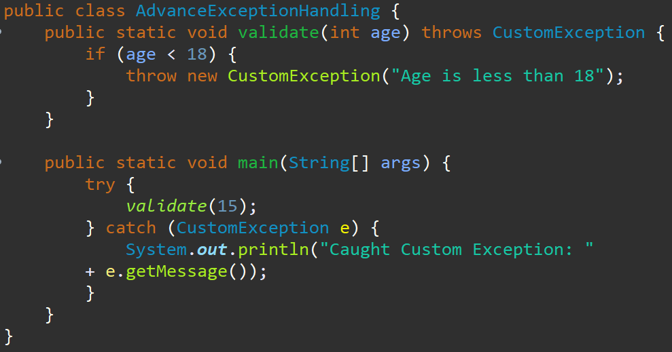
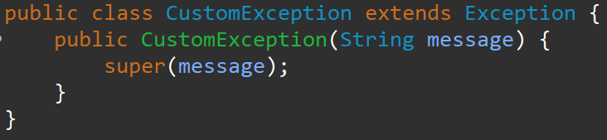
Sample Java Code for Advanced Exception Handling and Custom Exceptions

Slide 26
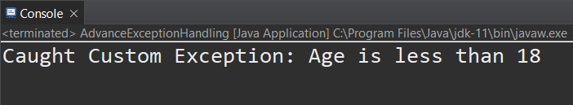
Sample Java Code for Advanced Exception Handling and Custom Exceptions

Slide 27
Summary
Wrapper Classes
Enable usage of primitives as objects.
Provide utility methods and support collections.
Key classes: Integer, Double, Boolean.
String Classes
String: Immutable character sequences.
StringBuffer: Mutable, thread-safe.
StringBuilder: Mutable, faster for single-threaded
Exception Handling
Manages runtime errors.
Key components: try, catch, finally, throw, throws.
Best practices: Specific catch blocks, logging, custom exceptions.

Slide 28
Thank You!

